Slide 1
Image Segmentation using u-Net
Dataset: Indian Pines Hyperspectral Dataset
Presented by: Vishva D Patel IU2441231791
Jenish Joshi IU2441231784

Slide 2
INTRODUCTION
Image segmentation is a computer vision task in which an image is divided into meaningful regions by assigning a class label to each pixel.
Unlike image classification, which assigns one label to an entire image, segmentation provides pixel-level predictions.
Applications:- Remote sensing , Medical image analysis , Autonomous vehicles , Agriculture , Land-cover mapping , Object recognition , Satellite image analysis

Slide 3
INDIAN PINES HYPERSPECTRAL DATASET
The Indian Pines dataset is a hyperspectral image dataset used to study and classify different regions or materials present in an image.
Unlike a normal RGB image, which has only 3 color channels, a hyperspectral image contains information from many spectral bands.

Slide 4
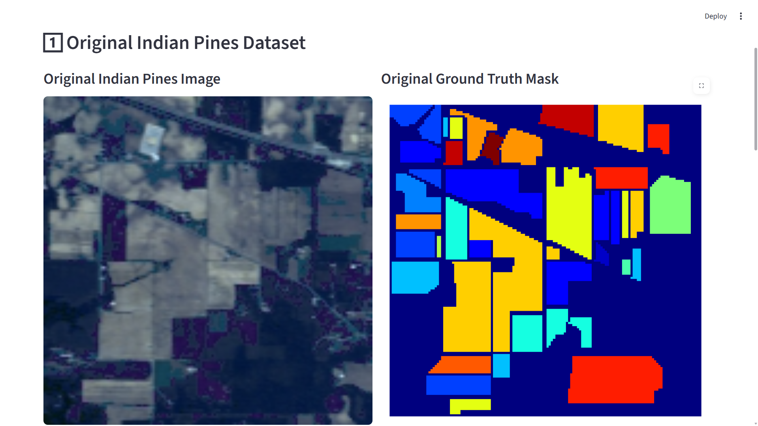
INDIAN PINES HYPERSPECTRAL DATASET

Slide 5
OUR DATASET
The image used in this project has:
Image size: 145 × 145 × 200
145 × 145 → height and width of the image
200 → number of spectral bands
The dataset also contains a ground-truth mask of size:145 × 145
This mask tells us the correct class of each pixel and is used as the reference while training the model.
The segmentation model is designed to identify 17 different classes in the image.

Slide 6
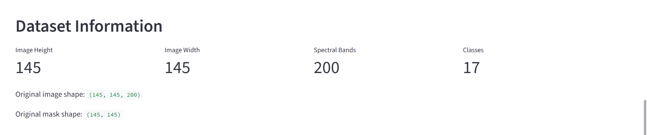
OUR DATASET

Slide 7
PROBLEM STATEMENT
A hyperspectral image contains a large amount of information for every pixel. The challenge is to automatically determine what class each pixel belongs to.
Manually identifying every pixel in a large image is:
Time-consuming
Difficult to perform consistently
Dependent on human expertise
Not practical for large amounts of image data
The goal of this project is to develop a deep-learning model that can automatically classify every pixel of the Indian Pines image into one of the 17 classes.

Slide 8
UNDERSTANDING IMAGE SEGMENTATION
Image segmentation means dividing an image into meaningful regions and assigning a class to each pixel.
For our project, the model looks at the image and determines which of the 17 classes each pixel belongs to.

Slide 9
WHY DO WE NEED DEEP LEARNING
The Indian Pines image contains a large amount of information because each pixel has information from 200 spectral bands.
Creating manual rules to identify all 17 classes would be difficult because different classes can have similar visual and spectral characteristics.
Deep Learning Helps By:
Learning patterns directly from the available data
Finding useful features automatically
Using both image information and spectral information
Making predictions for unseen image patches
Reducing the need for manually designed rules

Slide 10
WHY U-NET
We need a model that can do two things:
Understand what is present in the image
Know exactly where those features are located
U-Net is well suited for this because it is designed specifically for pixel-level image segmentation.
Main Advantages of U-Net
It can learn important features from the input image.
It can preserve useful spatial information.
It can produce a prediction for every pixel.
It uses skip connections to retain fine details.
It works well even when the amount of training data is limited.

Slide 11
HOW DOES U-NET WORK
U-Net works in three main stages:
Encoder — Understand the image
Bottleneck — Capture important information
Decoder — Create the segmentation map
The input image first goes through the encoder, where the model learns useful patterns. The decoder then uses this information to produce the final pixel-by-pixel prediction.

Slide 12
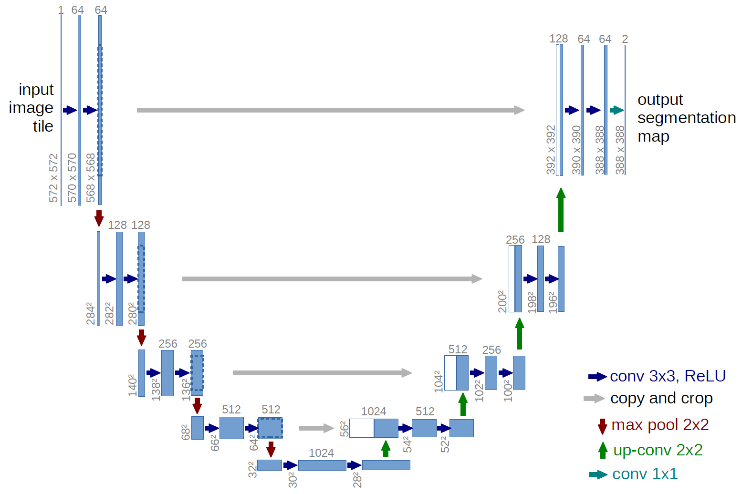
U-NET ARCHITECTURE

Slide 13
U-NET ARCHITECTURE
U-Net has two main paths:
Contracting Path — Encoder
The left side of the network.
Gradually reduces the image size.
Learns important patterns and features from the image.
As the image becomes smaller, the network learns more complex information.
Expanding Path — Decoder
The right side of the network.
Gradually increases the image size again.
Uses the learned features to create the segmentation result.
Finally produces a class prediction for every pixel.

Slide 14
U-NET ARCHITECTURE
Skip Connections
Connect the encoder to the decoder.
Pass useful details directly from the encoder to the decoder.
Help the network preserve the location and boundaries of objects.

Slide 15
ENCODER: UNDERSTANDING THE IMAGE
The encoder is the left side of the U-Net architecture.
Its main job is to look at the input image and learn important features.
At the beginning, the network looks at simple information such as:
Edges
Patterns
Textures
Local variations
As we move deeper into the encoder, it learns more complex and meaningful features.

Slide 16
ENCODER: UNDERSTANDING THE IMAGE
The encoder repeatedly applies:
Convolution → Batch Normalization → ReLU → Convolution → BatchNormalization → ReLU → Max Pooling
The pooling operation reduces the spatial size of the feature maps.
At the same time, the network can learn increasingly complex features.

Slide 17
ENCODER: UNDERSTANDING THE IMAGE
Convolution
The convolution layer looks at small regions of the input and detects useful patterns.
At the beginning, these can be simple patterns such as:
Edges
Lines
Textures
Small shapes
As we go deeper into the network, the convolution layers learn more complex patterns.

Slide 18
ENCODER: UNDERSTANDING THE IMAGE
Batch Normalization
After convolution, Batch Normalization is applied.
Its purpose is to keep the values flowing through the network more stable, which helps the model train effectively.
ReLU Activation
Next, the ReLU activation function is applied.
It introduces non-linearity into the network, allowing the model to learn complex relationships rather than only simple linear patterns.`

Slide 19
ENCODER: UNDERSTANDING THE IMAGE
Second Convolution Block
The second convolution extracts additional features from the information produced by the first convolution.
Max Pooling
Finally, Max Pooling reduces the spatial size of the feature map.

Slide 20
BOTTLENECK: THE DEEPEST PART OF U-NET
What is the Bottleneck?
The bottleneck is the deepest part of the U-Net, located between the encoder and decoder.
By the time the input reaches this stage:
The spatial dimensions have been reduced.
The network has extracted important features from the image.
The feature representation contains more high-level information.
In our implementation, the encoder reduces the spatial representation to approximately: 128 × 8 × 8

Slide 21
DECODER: RECONSTRUCTING THE SEGMENTATION MAP
What Does the Decoder Do?
The decoder is the right side of the U-Net.
Its main job is to take the compact features learned by the encoder and gradually restore the spatial dimensions to produce the final segmentation map.
How Does It Work?
The decoder mainly performs:
Upsampling → Feature Combination → Convolution → Feature Refinement

Slide 22
SKIP CONNECTIONS: PRESERVING IMPORTANT DETAILS
Why Are Skip Connections Needed?
When the encoder reduces the image size using pooling, some fine spatial details can be lost.
For segmentation, these details are important because the model needs to know exactly where each class is located.
U-Net solves this using skip connections.
How They Work
Skip connections directly transfer feature information from the encoder to the corresponding stage of the decoder.
The decoder combines:
Information from the encoder + Information from the decode

Slide 23
PREPARING THE IMAGE FOR U-NET
From Original Image to U-Net Input
Our original hyperspectral image is too large to directly use as a single small input to the U-Net.
Therefore, we divide the image into smaller 32 × 32 patches.
Why Do We Use Patches?
Using smaller patches makes the data easier for the model to process and allows the model to learn from different regions of the image.
Each patch contains:
200 spectral bands
32 × 32 spatial pixels
The corresponding ground-truth patch has:
32 × 32

Slide 24
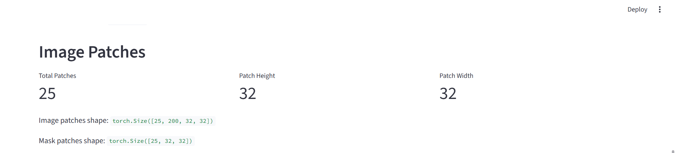
PREPARING THE IMAGE FOR U-NET

Slide 25
TRAINING, VALIDATION AND TESTING
How Do We Train and Evaluate the Model?
After dividing the image into 25 patches, we separate them into three groups.
Purpose | Patches
Training Dataset | 17
Validation Dataset | 4
Testing Dataset | 4
Total | 25

Slide 26
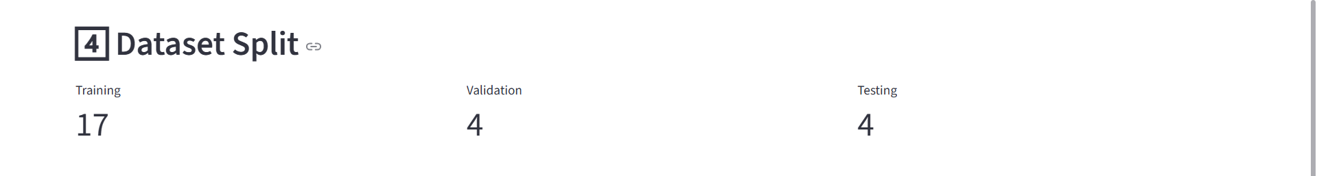
TRAINING, VALIDATION AND TESTING

Slide 27
TRAINING PROCESS
The U-Net learns by comparing its prediction with the correct ground-truth mask.
The process is repeated for many training cycles called epochs.

Slide 28
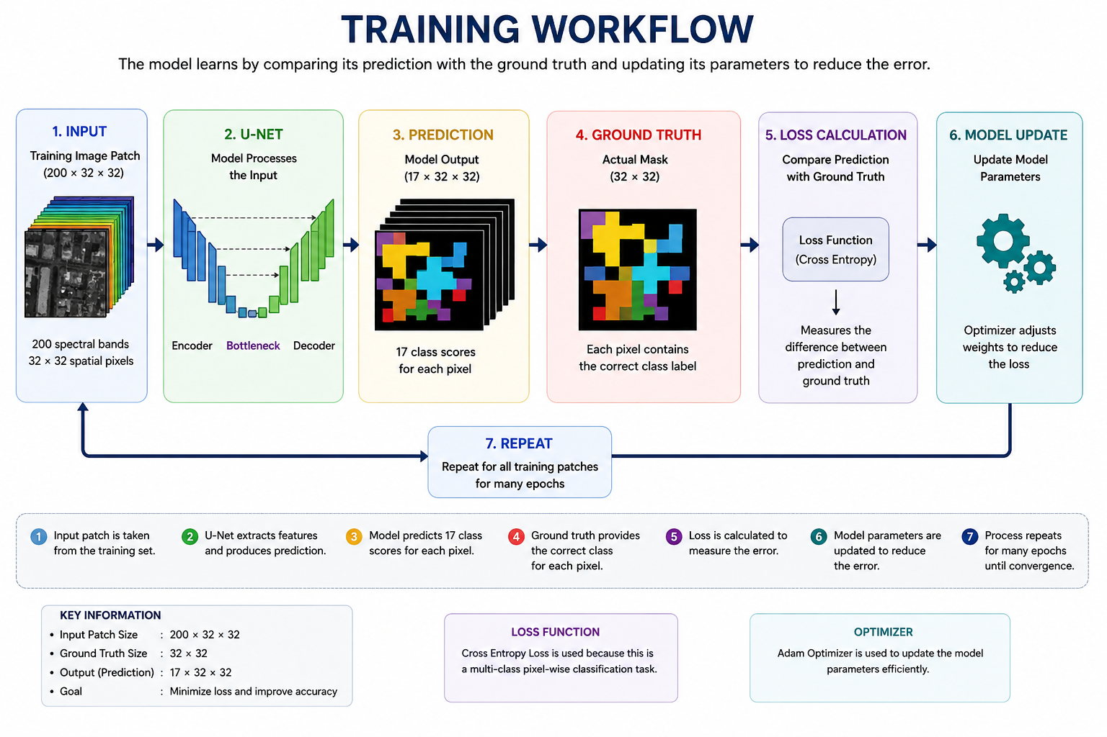
TRAINING PROCESS

Slide 29
TRAINING PROCESS
What Happens During Training?
Input
A training patch of size: 200 × 32 × 32 is given to the U-Net.
Prediction
The U-Net predicts a class for every pixel.
Comparison
The prediction is compared with the correct ground-truth mask.
Loss Calculation
The difference between the prediction and the correct answer is measured using a loss function.
Model Update
The model adjusts its internal parameters so that its future predictions can become better.

Slide 30
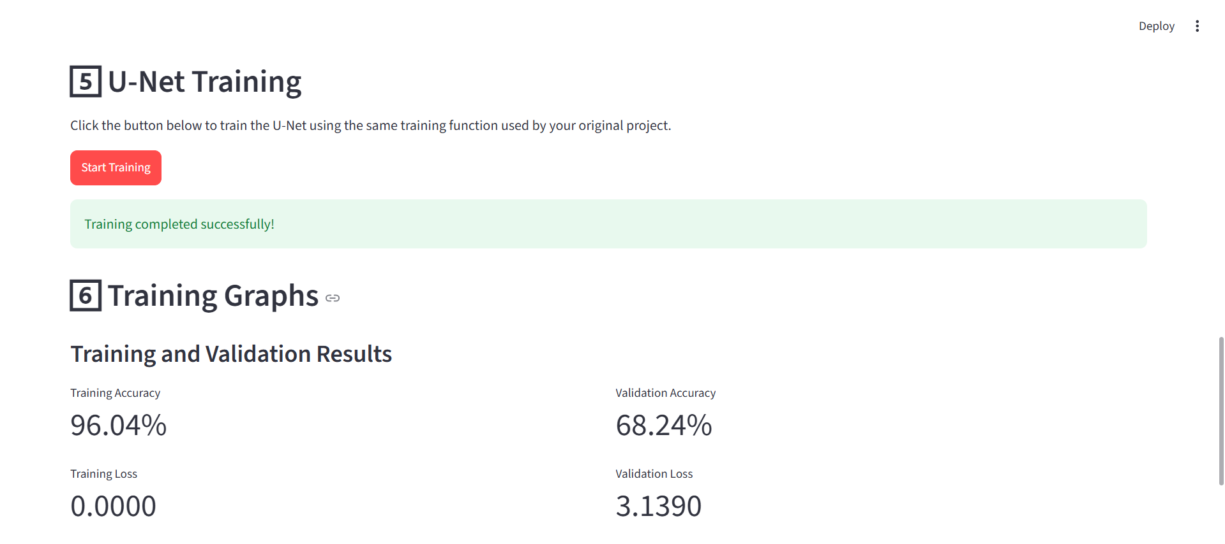
TRAINING RESULTS

Slide 31
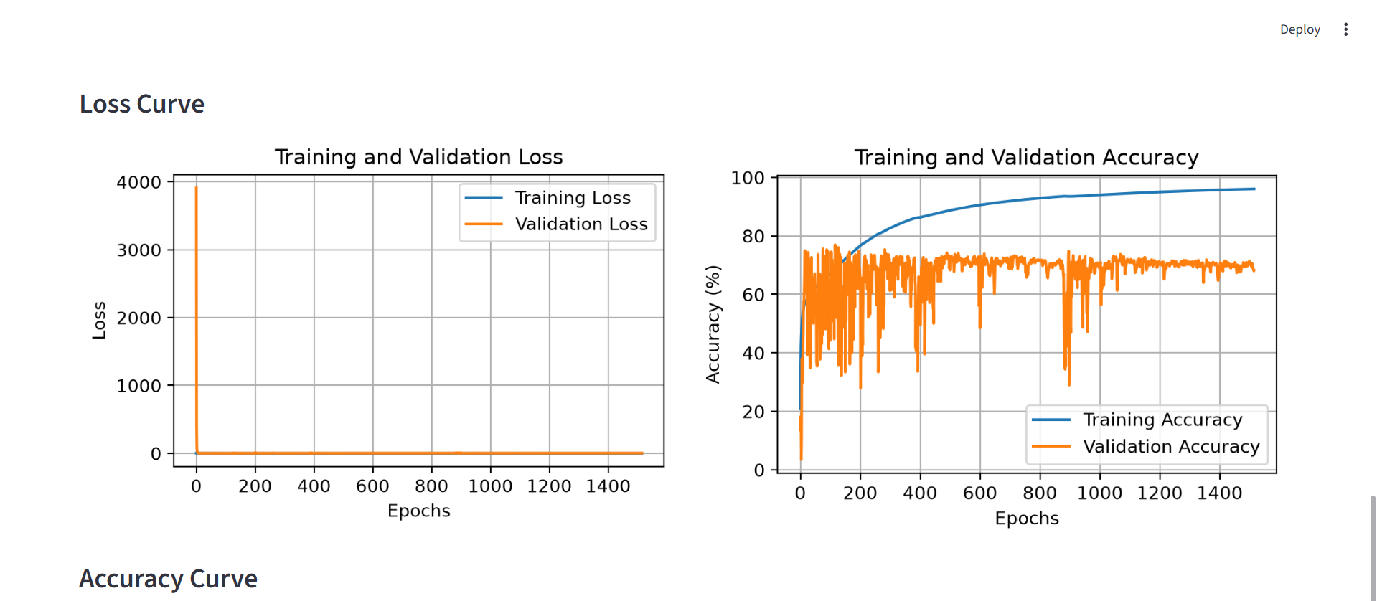
TRAINING RESULTS

Slide 32
VALIDATION AND PREDICTION
How Does the Trained Model Perform on Unseen Data?
After training, we test the model on image patches that were not used to train the model.
For validation, the model compares its predicted mask with the actual ground-truth mask.

Slide 33
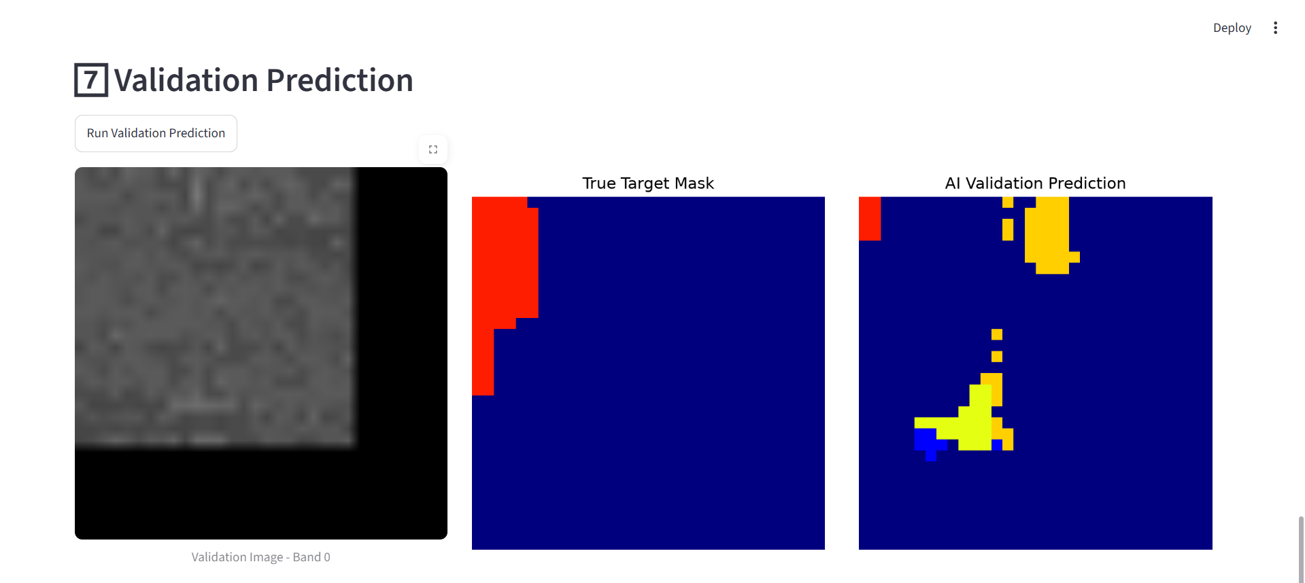
VALIDATION RESULT

Slide 34
TESTING RESULTS
Final Evaluation on Unseen Data
After training and validation, the model is evaluated on the 4 test patches that were kept separate from the training process.

Slide 35
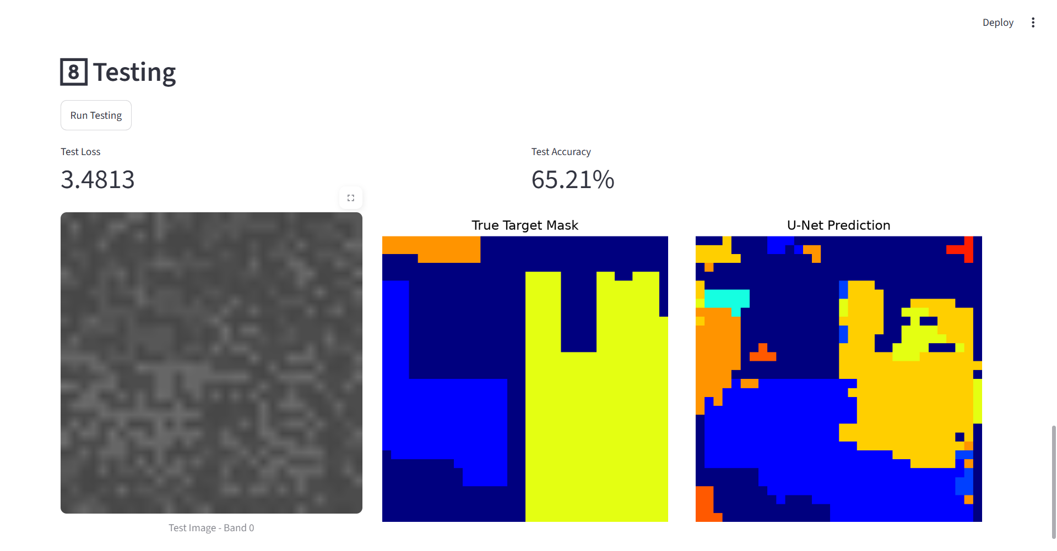
TESTING RESULTS

Slide 36
FULL IMAGE RECONSTRUCTION
Reconstructing the Complete Segmentation Map
Until now, the U-Net has been working with individual 32 × 32 patches.
To obtain the segmentation result for the complete image, we combine the predictions from all 25 patches and place them back in their original positions.

Slide 37
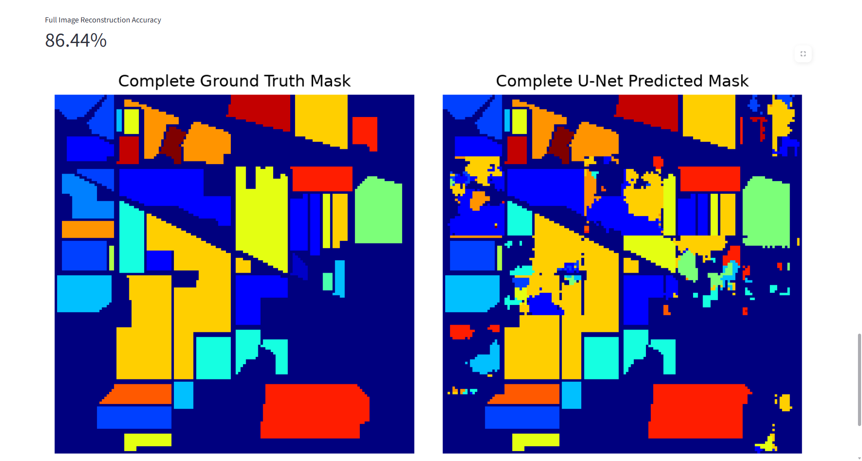
FULL IMAGE RECONSTRUCTION RESULT

Slide 38
THANK YOU
Questions & Discussion
U-Net for Image Segmentation used items are :-
Indian Pines Hyperspectral Dataset
Python • PyTorch • Streamlit

